Slide 1



Chemflow Global Supply
The Future of Agile Chemical Distribution

Slide 2
Vision
&
Mission
Vision
To be the most cost-competitive alternative for manufacturers in the region.
Commitment to Quality
Providing fit-for-purpose materials backed by technical and regulatory expertise.
The Goal
Facilitating a seamless and smooth transition for our partners.

Slide 3

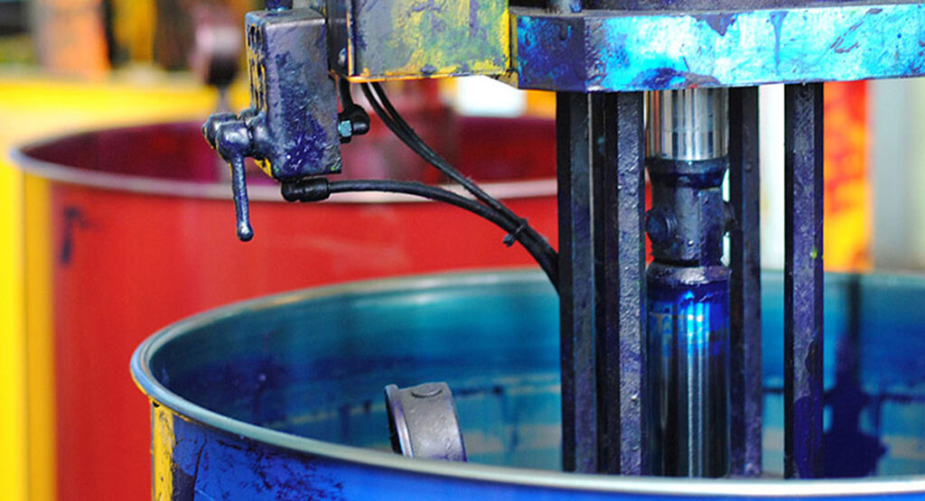
Our Markets
Agrochemical
Agriculture is a crucial economic pillar for South East Asia, contributing roughly 9% to region’s GDP and employing one-third of its workforce. Growth driven by rising population and increasing demand for food.
Paint and Coatings
Robust and evolving sector, integral to the region’s rapid infrastructural development and being key destination for shipbuilding and ship repair.

Slide 4
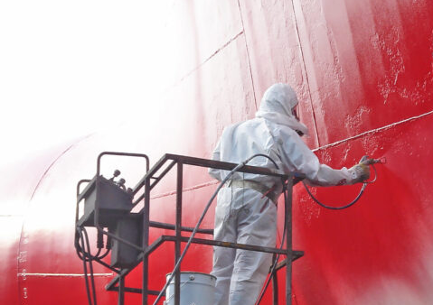





Market Opportunity: Paints and Coatings
Sector Focus
High demand remains for marine, and protective coatings. Major dry dock and supply vessels new building region.
The Import Gap
Nearly 90% of raw materials for paint in this region are imported.
The Key Players
Market dominated by Nippon, International Paint, Hempel, PPG, Jotun, and Chugoku.
The Critical Challenge
Intense competition and low margins mean manufacturers must find ways to lower costs.

Slide 5
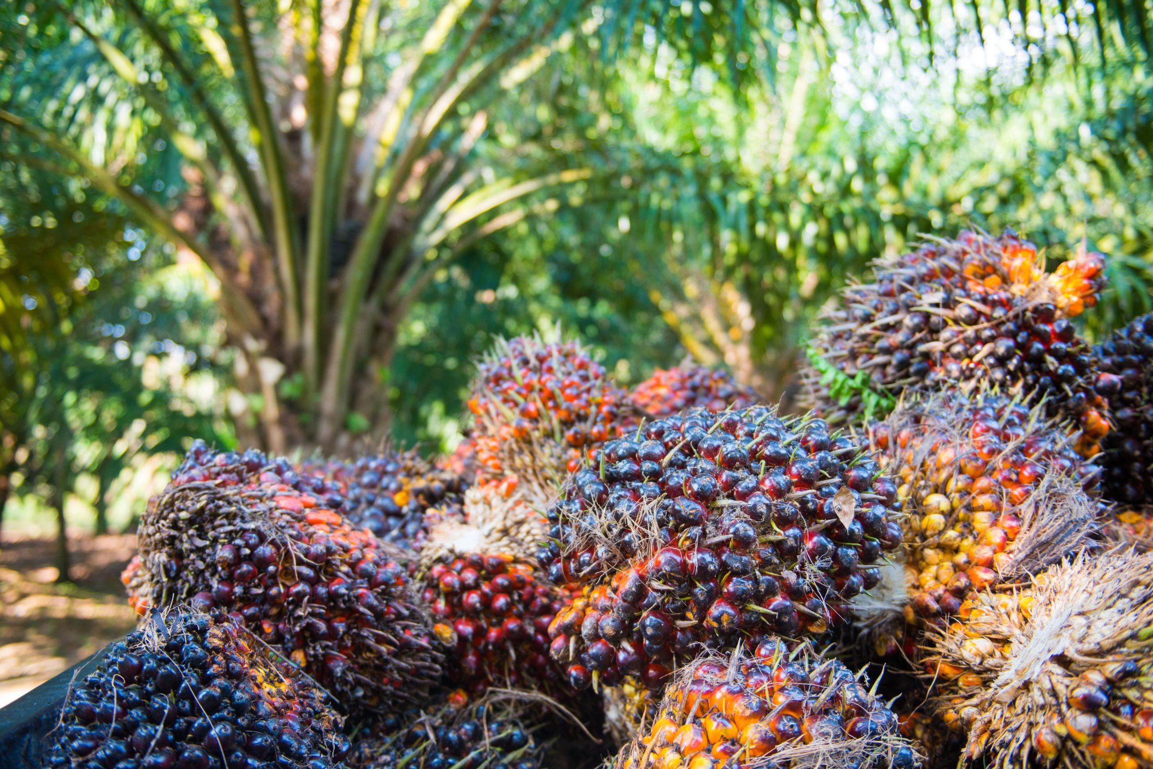


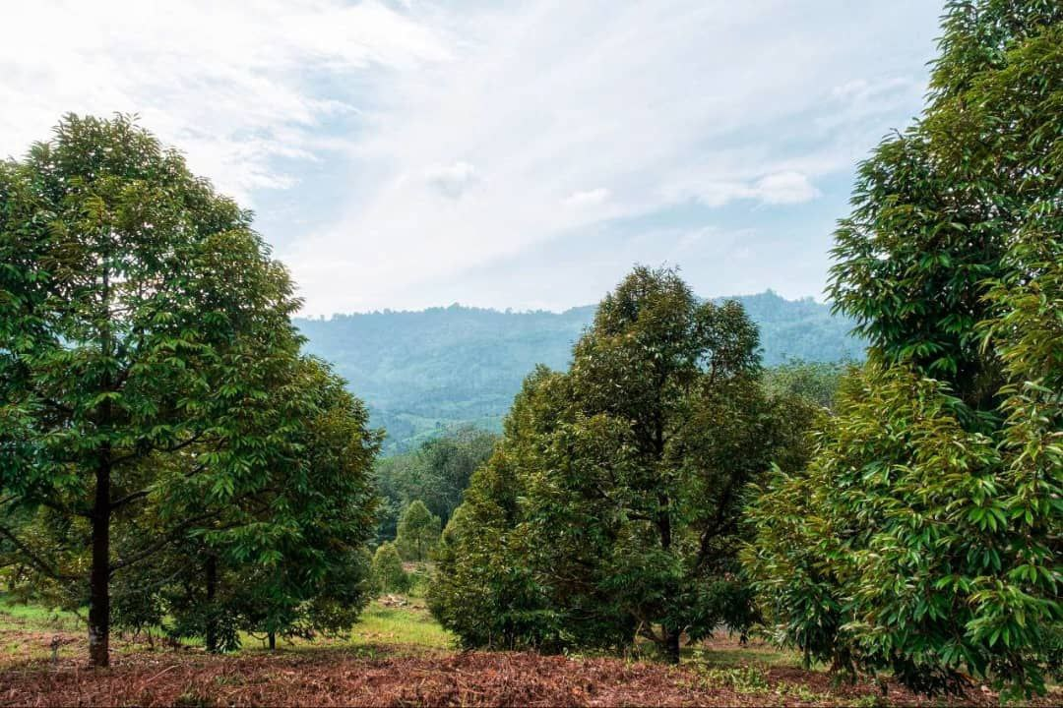
Market Opportunity: Agrochemical
Sector Focus
Total population of 700 million. Produces 30% of the world's rice, 85% of world’s palm oil. Increase demand to improve quality and yield.
Fragmented
Accelerated shift toward diversified sourcing, reducing reliance on single suppliers.
The Key Players
Market dominated by Yara, BASF, Behn Meye Syngenta, Papuk Kaltim, Petronas.
The Critical Challenge
Costs remain the main consideration, however, greater attention on sustainability and quality.

Slide 6

Value Proposition for PRINCIPLES (SUPPLIERS)
Market Entry
We offer an agile, low-investment path for producers to expand into Southeast Asia.
Speed to Market
Our local team services customers directly for effective product reach.
Lower Cost to Serve
Chemflow handles all local administrative and import documentation on your behalf.
Distribution
We provide a fast, cost-effective channel for regional product distribution.

Slide 7
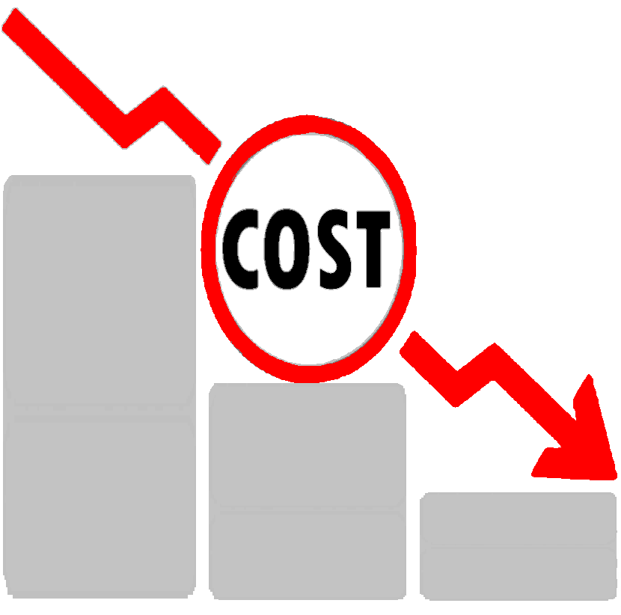
Value Proposition for Customers
Cost Leadership
We source competitive materials to help you maintain a sustainable cost structure.
Technical Security
We provide expert application development and performance optimization.
Risk Mitigation
Comprehensive sampling services and COA allow for thorough evaluation before purchase.
Global Reach
We source quality materials directly from the "World’s Factory".

Slide 8

Our Seamless Process
Stage 1
Strategic Sourcing
Action
Identifying cost-competitive raw materials
Benefit
Cost-competitive alternative.
Focus
Mapping materials fit for customer
Regulatory Handling all local documentations.
Documentation Support for every batch.
Action
Sampling service for evaluation.
Stage 2
Validation & Compliance
Stage 3
Technical Optimization
Action
Expert technical support.
Performance Fine-tuning formulations.
Transition Managing the operational change
Sustainability Maintaining a lean cost structure.
Speed
Products reach the customer efficiently.
Action
Local operation and customer service
Stage 4
Localized Delivery & Support

Slide 9
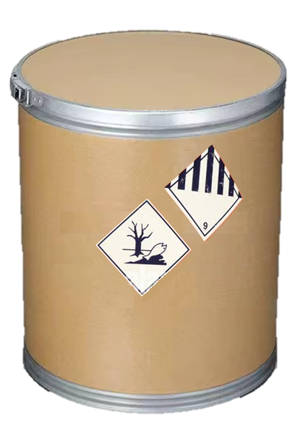
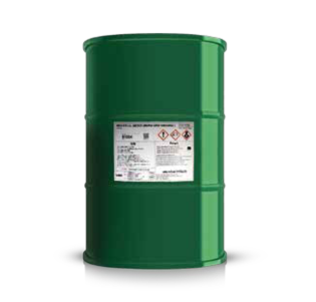
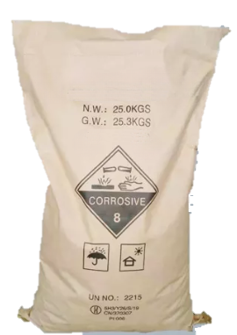
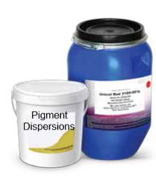
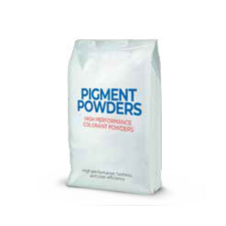
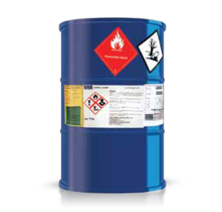
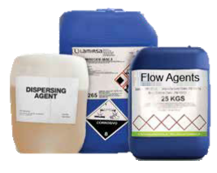
Our Offerings
Agrochemical
Crop protection intermediates
Agro Conditioners
Paints & Coatings
Pigments
Paint Driers
Additives

